Slide 1


EMPLOYEE DATA ANASLYSIS USING EXCEL
STUDENT NAME:K.POOJA
RESISTOR NO:asunm110unm12201374
DEPARTMENT:B.COM(GENERAL)
COLLEGE:D.R.B.C.C.C.HINDU COLLEGE

Slide 2

PROJECT TITTLE
EMPLOYEEPEARFORMANCE ANALYSIS USING EXCEL

Slide 3
AGENDA:
1.PROBLEM STEATMENT
2.PROJECT OVERVIEW
3.END USERS
4.OUR SOLUTION AND PROPOSITION
5.DATASET DESCRIPTION
6.MODELLING APPROACH
7.RESULTS AND DISCUSSION
8.CONCULSION

Slide 4
PROBLEM STATEMENT
Problem Statement:Analyze the factors contributing to employee turnover in the organization, focusing on key metrics such as turnover rates, experience levels, work locations, departments, and gender. The goal is to identify patterns or trends that may indicate reasons for high turnover and to provide actionable insights that can help in developing strategies to reduce turnover.Key Objectives:Turnover Rate Analysis: Determine the turnover rates across different departments, locations, genders, and experience levels.Experience vs. Turnover Correlation: Analyze how the experience level of employees correlates with turnover amounts.Location Impact: Investigate whether work location (New Delhi, Bangalore, Pune) significantly impacts turnover

Slide 5

PROJECT OVERVIEW
main objective of this project is to analyze the employee turnover data to identify patterns, trends, and key factors contributing to turnover in the organization. This analysis aims to provide insights that can help reduce turnover rates and improve employee retention strategies.Data Description:The dataset includes 35 employee records with the following attributes:Name: The employee's name.Joining Year: The year the employee joined the organization.Gender: The gender of the employee (Male/Female).Turnover: The turnover amount associated with each employee.Experience: The number of years of experience the employee has

Slide 6
Turnover by Gender:The data shows both male and female employees with varying turnover amounts, but a deeper analysis could reveal if there's a significant difference in turnover between genders.Turnover by Department:Departments like finance, quality, sales, and purchase are represented. Analysis could determine which department has the highest turnover and identify any patterns.Turnover by Work Location:Work locations include New Delhi, Bangalore, and Pune. A location-based analysis might show if certain locations have higher turnover rates.
END USERS
Turnover by Gender:The data shows both male and female employees with varying turnover amounts, but a deeper analysis could reveal if there's a significant difference in turnover between genders.Turnover by Department:Departments like finance, quality, sales, and purchase are represented. Analysis could determine which department has the highest turnover and identify any patterns.Turnover by Work Location:Work locations include New Delhi, Bangalore, and Pune. A location-based analysis might show if certain locations have higher turnover rates.

Slide 7
OUR SOLUTION AND PROPOSITION
Turnover by Department:Finance and Quality have notable turnover, with significant cases across all locations.Sales also shows high turnover, especially in New Delhi and Bangalore.Turnover by Work Location:Bangalore has the highest turnover, followed by Pune and New Delhi. Analyzing the reasons for high turnover in Bangalore could be insightful.Turnover by Gender:Both male and female employees exhibit turnover, but the data shows that males slightly dominate the turnover figures. Investigating gender-specific factors could be helpful.Turnover by Experience and Joining Year:Employees with both low (1-3 years) and moderate experience (5-8 years) show high turnover.

Slide 8

Name: The employee's name.Joining Year: The year the employee joined the company.Gender: The gender of the employee (MALE or FEMALE).Turnover: The amount of turnover associated with the employee (likely the total sales or financial impact they generated).Experience: The number of years of experience the employee has.Work Location: The city where the employee works (e.g., New Delhi, Bangalore, Pune).Department: The department the employee is part of (e.g., sales, finance, quality, purchase).
DATA DESCRIPTION
Name: The employee's name.Joining Year: The year the employee joined the company.Gender: The gender of the employee (MALE or FEMALE).Turnover: The amount of turnover associated with the employee (likely the total sales or financial impact they generated).Experience: The number of years of experience the employee has.Work Location: The city where the employee works (e.g., New Delhi, Bangalore, Pune).Department: The department the employee is part of (e.g., sales, finance, quality, purchase).

Slide 9
MODELLING APPROACH
Data Preparationa. Data Cleaning:Ensure there are no missing or inconsistent values in key fields (e.g., TURNOVER, EXPERIENCE, etc.).Convert categorical variables (e.g., GENDER, WORK LOCATION, DEPARTMENT) into numerical format using encoding techniques (e.g., one-hot encoding).b. Feature Engineering:Turnover Amount: This could be the target variable if you're predicting turnover amounts.Experience Level: Could be a feature influencing turnover.Joining Year: Create a feature representing the number of years since joining.Department and Location: Create dummy variables for these categorical features

Slide 10
DISCUSSION
Data OverviewGeneral Characteristics:Joining Years: Employees joined between 2012 and 2018.Work Locations: The primary locations are Bangalore, New Delhi, and Pune.Departments: Includes Sales, Finance, Quality, and Purchase.2. Key InsightsTurnover by Department:Finance: Generally high turnover amounts (e.g., Reina Oliver, Yara Keith).Sales: Varies significantly; some employees have very high turnover (e.g., Remy Sweeney).Quality: Consistent turnover but with less variability compared to sales and finance.Turnover by Location:Bangalore: A high concentration of employees with varied turnover amounts.Pune: Employees here also show high turnover, especially in sales.New Delhi: Mixed turnover with notable figures in both finance and qua

Slide 11
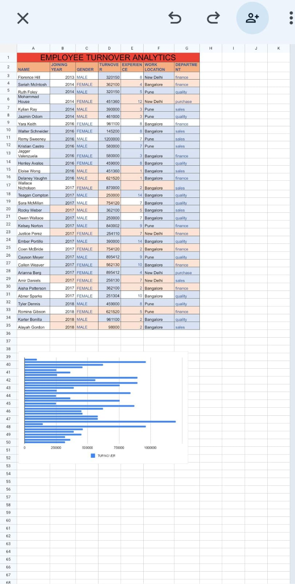
RESULTS

Slide 12

Departmental Turnover Patterns:Finance: Shows some of the highest turnover values, particularly notable in Bangalore. Employees with significant turnover in finance positions may be tied to high-value transactions or financial pressures.Sales: Displays a wide range of turnover values, with some extremely high amounts (e.g., Remy Sweeney). This could indicate high volatility or performance-based compensation influencing turnover.Quality: Generally consistent turnover amounts, with higher turnover in Bangalore and Pune. This may reflect stability or challenges in maintaining quality standards.Location-Based Insights:Bangalore: Home to many employees with high turnover amounts, especially in finance and sales departments. This suggests potential location-specific issues such as competitive market conditions or higher living co
CONCULSION
Departmental Turnover Patterns:Finance: Shows some of the highest turnover values, particularly notable in Bangalore. Employees with significant turnover in finance positions may be tied to high-value transactions or financial pressures.Sales: Displays a wide range of turnover values, with some extremely high amounts (e.g., Remy Sweeney). This could indicate high volatility or performance-based compensation influencing turnover.Quality: Generally consistent turnover amounts, with higher turnover in Bangalore and Pune. This may reflect stability or challenges in maintaining quality standards.Location-Based Insights:Bangalore: Home to many employees with high turnover amounts, especially in finance and sales departments. This suggests potential location-specific issues such as competitive market conditions or higher living co

Slide 13
THANK YOU

